Slide 1
Diversification of search results by exploiting entity relationships in web search queries
Course Project
CS 5246 – Text Processing on the Web
Muthu Kumar C.
Senthil Kumar Chandramohan
Lee Jia Wei Shaun

Slide 2
Web Information Retrieval
Addresses information needs of the majority
Popular interpretation(s) of search queries
Using query logs
Extensions to traditional approach
Teevan et al., 2005 : user personal profiles
Lu et al., 2010 : user’s geographic location
Need a general approach to address a wider range of users.
Notes:
Large number of queries to profile the user
IP hiding problem, foreigner

Slide 3
Diversifying search results
Motivation
Lack of information specific enough to retrieve results that accurately satisfies the users’ information needs.
Since we can’t be precise we have to guess
and guess more..
More guesses → More chances of satisfying user’s information need.
Increase recall.

Slide 4

Diversifying search results
Rose and Levinson, 2004
Traditional PRP will not work
Need to model diversity as a parameter
Now optimization depends on two factors
Lack of information : many grounds
Types of diversity
Notes:
Bicriterian optimization problem

Slide 5
Related work
Agarwal et al 2009
Diversification algorithm disambiguates query assuming a taxonomy.
Gollapudi and Sharma, 2009
Axiomatic approach for result diversification
Proved no algorithm can satisfy all the axioms
Semantics based diversity – disambiguation
Topical diversity – taxonomy based
Notes:
GS – rerank search to imply diversification

Slide 6
Related work
Selectively diversifying queries
Santos et al.,
2010a – XQUAD framework
Capture query aspects as sub-queries
2010 b – Selective diversification
learning the relevance, diversity tradeoff
Bhatia et al, 2012
Selective, typified diversification using query logs.

Slide 7
Solution approach
Semantic web resources
Taxonomy of things
Wikipedia
Wiki Disambiguation pages
Wikipedia Category pages
Dbpedia
Machine readable Wikipedia
Mirrors Wikipedia main pages
Wikipedia category pages

Slide 8
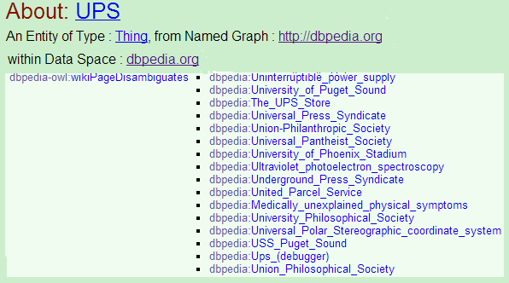
Step 1
Diversity based on semantic disambiguation
UPS
Notes:
One wikipedia and Dbpedia page
One disamb page
One category page

Slide 9
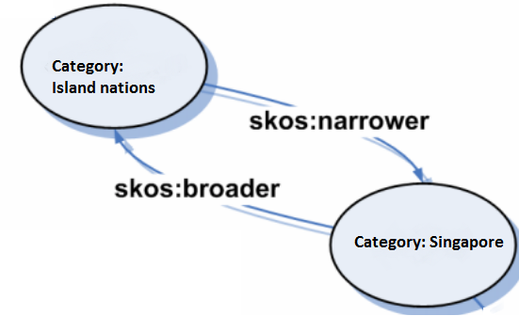
Dbpedia : Category Network
Simple Knowledge Organization System(SKOS)
Basic entity – SKOS : Concept
Relationships
skos: broader
skos: narrower

Slide 10
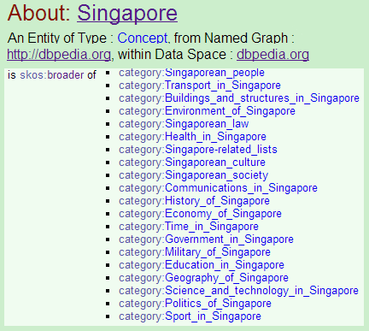
Step 2
Topical diversity
Singapore

Slide 11
Reformulating queries
Jones et. al 2006
Substituting parts of a query.
Comprehensive analysis – Various relations of reformulation to original query.
Precise rewrite – syntax/spelling change
Approximate rewrite – Broaden/Specialize
Possible rewrite – Some other association relation
Unrelated in semantics (disambiguation)

Slide 12
Step 3
Generalizing to diversify search results
Use complete query when one can.
Absence of result from steps 1 and 2 would mean:
Query is unambiguous enough to be identified
Query could not be recognized as a topic with subtopics
Make bigrams of the search query and search for category matches.
Substitute matched bigram by broader categories

Slide 13
Step 4
Step 3 looks for categories.
Categories might not be named entities.
All named entities are not categories.
So, next we try to detect NE in queries.
Dbpedia lookup service
Named Entity Recognition in Queries (NERQ)
Traditional NER is not accurate due to loss of context.

Slide 14
NERQ
Guo et al., 2009
70% queries contain named entities
1% contain more than one named entity
Pasca, 2004
Extracted categories for NE and used the hierarchical relationship to refine queries.
Pasca, 2007
Extracted named entities from Web search queries.
Notes:
Many inclding Guo et al. found web search queries contain 2 to 3 words

Slide 15
NER using crowd sourced data
Cucerzan, 2007
NER using Context occurrences in Wikipedia.
Hoffart et al., 2011
Entity disambiguation using Knowledge bases
We use Dbpedia as a dictionary to check for people and person entities.
Complexities:
“Microsoft Ofiice”. Microsoft in itself is an entity
But in a search “Microsoft office reviews”, to substitute Microsoft with Apple or Software companies is incorrect.

Slide 16
A nicer example
“hayley westenra the last rose of summer”
Homogenous from the perspective a user who is not too familiar about Ms. Westenra’s songs
“hayley westenra irish songs”
Lists all Irish songs by Ms. Westenra, most of her hit singles.
“Opera crossover singers the last rose of summer”
Yes of course, we can’t capture (1) right now as we only look at bigrams.

Slide 17


Ranking reformulations
Santos et al. 2010a Eq. 8, Eq. 9

Slide 18
Dataset
TREC 2009 Million Query(MQ) Dataset
Set of 40,000 queries
But we used just the top 50
Limitation due to Google custom search
100 queries per account/day

Slide 19
Errors
Non-capture by earlier steps
Eg. “Orange County Convention Center”
Step 3 substitutes for Orange County
Although, not incorrect when specific information is available, it could be inappropriate to deviate.
Diversity limited by data sources.
Eg. Acronyms list is not exhaustive in Wikipedia

Slide 20
Future work
Relation between entities.
One entity is a property of the other.
Eg. M.Gandhi was born in India
Categories associated to one another.
Longer paths linking entities may not be useful
for web search

